Slide 1
High Gain Microstrip Antenna Designs for A Doppler Radar
EE491-PROJECT
Ahmet Yasin Bulut - 250206001
Emre Nedim Hepsağ - 250206012
Advisor: Fatih Yaman
Notes:
Hello, we are ahmet and emre.
In this presentation, we will talk about our project work.

Slide 2
OUTLINE
Introduction
Problem Definition
Proposed Solution
Result and Discussion
Conclusion
Notes:
Today, we will first give introductive information about the area.
Then we will mention the problems we consider.
After that we will show our solutions, how these are resulted and the conclusion of the work.

Slide 3
INTRODUCTION
Microstrip Patch Antennas
Doppler Radars
Antenna Parameters
Notes:
First, we will talk about microstrip antennas, radars and parameters of the antennas

Slide 4
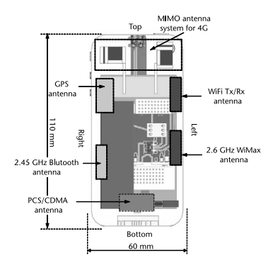
Microstrip Patch Antennas
Antenna Applications
Antenna Types
Printed Antennas
Notes:
As an engineer we know that, we are surrounded by antennas in our lives. Even in a small smartphone like the figure there are antennas for different application such as bluetooth, wifi, GPS, RFID or FM radio.
Compared to other antennas, printed antennas are easy to manufacture, they have low weight, and they are small. The most common and simple printed antenna type is the microstrip patch antenna. We can see them in radars, mobile phones, satellites or gps systems.

Slide 5
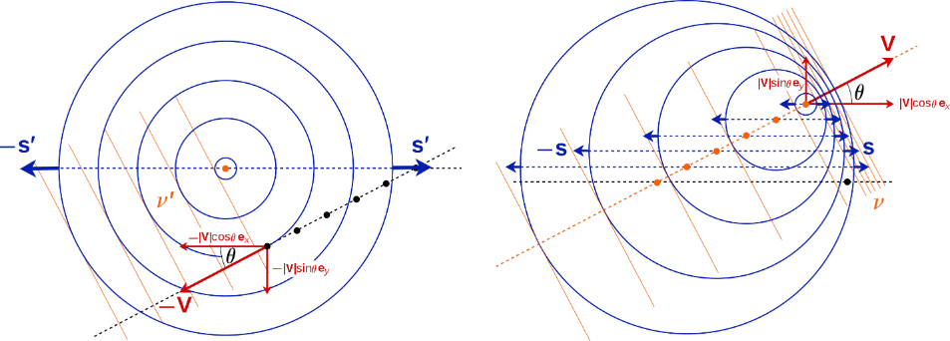
Doppler Radars
Radar
Doppler Effect
Doppler Radar Implementation
Notes:
A radar is an electromagnetic sensor to determine the distance, angle or velocity of an object. In this project we concerned with doppler radar. Doppler is an effect which happens when an object has a velocity relation to the wave source or observer. Doppler radar uses this effect to detect the speed of an object. It allows narrow band applications, so microstrip patch antenna is a good type for this application. But antennas has other important parameters which we need to consider besides the frequency band.

Slide 6
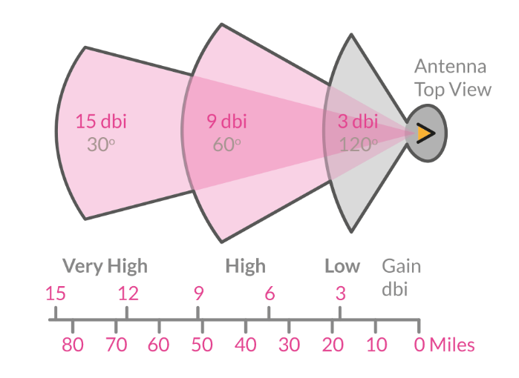
Antenna Parameters
Return Loss
Radiation Pattern
Directivity
Gain
Impedance
Notes:
In designing antennas its very important to consider parameters which shows the important characteristics of your design.
In signal transmission, some power always returns back to source which is called return loss or S11 parameter. We need to adjust the S11 parameter to have lower reflection on operating frequency.
The other important parameter is farfield pattern or radiation pattern. We use directiviy and gain to describe it. The gain directly increases our transmission distance and in a doppler radar application we want to be focused on one direction as we see on the example figure.

Slide 7
PROBLEM DEFINITION
Antenna Size & Structures
Feed Methods & Feed Networks
Directivities of Different Structures
Final Design for Fabrication
Fabrication Cost
Notes:
Hello I am emre, I will continue with the problems of our Project by menioning them one by one.

Slide 8
Antenna Size & Structures
Patch Shape
Rectangular, round…
Substrate Materials
FR4, Roger, RO4730…
Array Structures
1x4, 2x2…
Notes:
At the beginning of our Project, we needed to design microstrip patch antenna by choosing a structure.
Even though there are a lot of different design concepts, We saw that the rectangular patch structure is very common on publications.
Also, there are various materials to use as a substrate such as FR4 and roger. Besides that we need high gain for our doppler radar, therefore we are supposed to consider using array structures with its possible tradeoffs.

Slide 9
Feed Methods & Feed Networks
Feed Types
Edge feed, inset feed, Coaxial feed…
Feed Networks
Series, parallel…
Notes:
While considering different design structures, we may need different feed and feed networks.
The feed must be adjusted to match the input impedance to consume power efficiently.
Also, its position is important because It can change some properties of our design, such as radiation pattern.

Slide 10
Directivities of Different Structures
Radiation Patterns
Optimal Design for Radar Application
Main beam
Side lobes
Notes:
Various patch shapes and feed systems cause different and unsymmetric radiation patterns.
For a doppler radar, the antenna directivity is an important factor, also we can increase the gain with decreasing the main beam width.
In our designs, we primarily aim for single dominant main lobe with small, close to -20 dB, side lobes. we also want the main lobe to be perpendicular and narrow for optimal results.

Slide 11
Final Design for Fabrication
Lack of information about material
Tolerate any shift on return loss
Notes:
Since we lack precise information of the dielectric constant, tangent loss and some other parameters of copper clad, we are supposed to improve our antenna to have wider band to handle any error.
Also, simulation and real-life circumstances are not the same so, we need a tollerable atnenna design.

Slide 12
Fabrication Cost
Low Cost Design
Cheap Materials
Decreasing the size
Vendor Production
Mass Production
Abroad Component Supply
Notes:
The production may cost more than we can provide.
PCB vendors mostly do mass production so, small productions such as our antenna has high price at those companies. Lastly, it takes time companies to produce our antenna and send it because of their busy schedule and logistics.
Lastly, If we want to produce the antenna on our own, we have limited options, such as UV exposure, or heat exposure method. However, The material and the process may be unreliable rather than Professional production.
Now Ahmet will go on with solutions

Slide 13
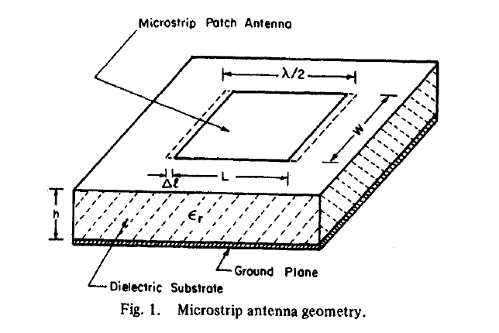
Antenna Size & Structures - I
Operating Frequency
FR4 Dielectric Constant
Width of the patch
Length of the patch
Notes:
We will now talk about our solutions for the problems emre mentioned
In designing the antenna, we first use the theoretical results and approximated equations which helps us to calculate the patch width and length to operate at 5.8 Ghz with FR4 material.

Slide 14
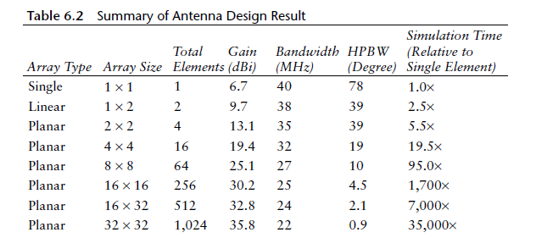
Antenna Size & Structures - II
Notes:
Moreover, we can change our antenna size by adding more patches and combine them.
In the figure, the gain of the antenna is significantly increased but with a tradeoff on bandwidth and complexicity.

Slide 15
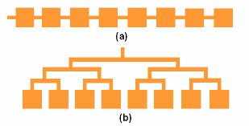
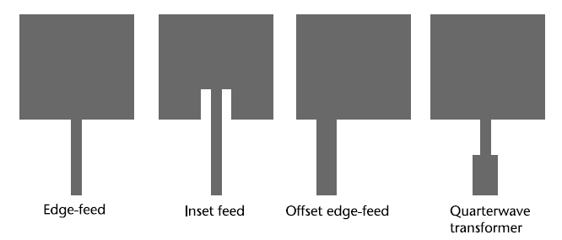
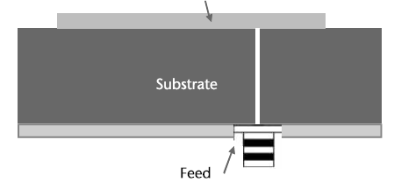
Feed Methods & Feed Networks
Feeding Methods
Feed Networks
Notes:
The feed method of the antenna is also important. There are different feed methods like coaxial feed and line feed as seen on the figures.
We used quarter wave and inset line feeds in our designs to make it simple and use them in feed networks.
Feed networks are needed in array antennas to feed them from one source. The flow of power can change radiation patterns, and become more complex to impedance match. In the figure we can see two basic feed networks. We mainly used the parallel feed networks.

Slide 16
Directivities of Different Structures
Single Patch
2x2 Patch
Side Feed 2x2 Patch
2x2 Patch Coax Feed
1x4 Patch
1x4 Patch 45 Degree
Notes:
For our directive high gain antenna, we try different patch structures to obtain most optimal design, we limited our patch number to 4, because we want a small and cheap antenna.

Slide 17
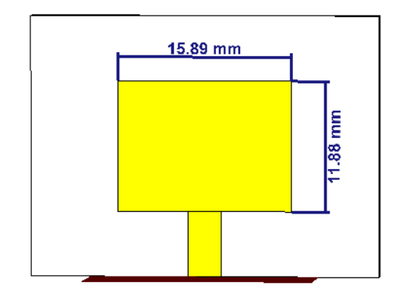
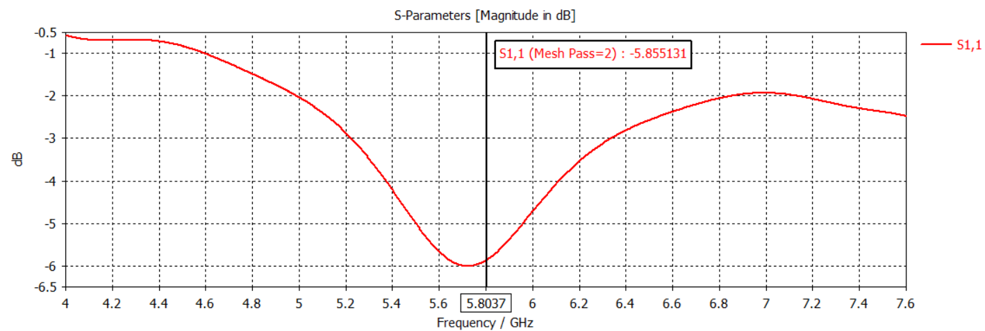
Single Patch
Approximate Functions
No impedance matching
Notes:
At the first we create a single patch from the theoritical values. As you can see the S11 results is very bad because of no matching.

Slide 18
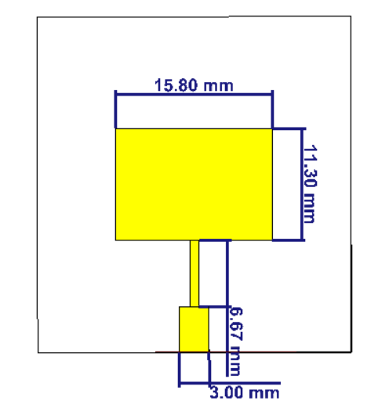
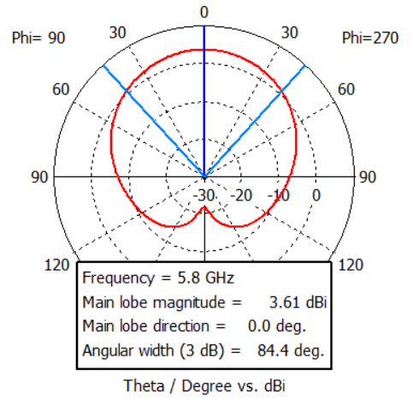
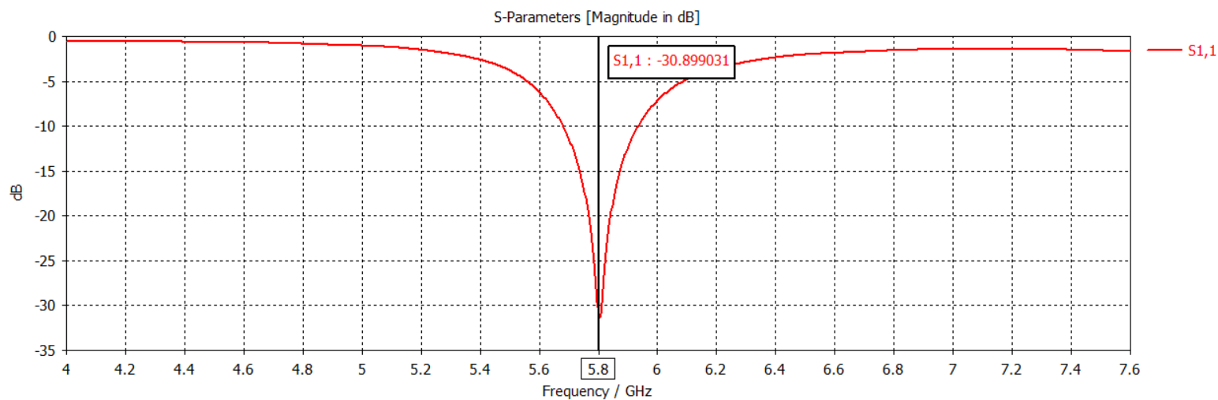
Single Patch - Improved
Adjustments on the geometry
Quarter-wave transformer
Notes:
Then we adjust the geometry and added quarter wave transformer at the end of patch, the result is very satisfying, but the gain of a single patch is limited, and the radiation pattern is very spread.
So we decided to design an array antenna.

Slide 19
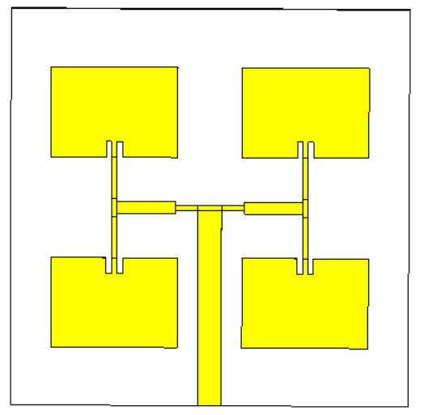
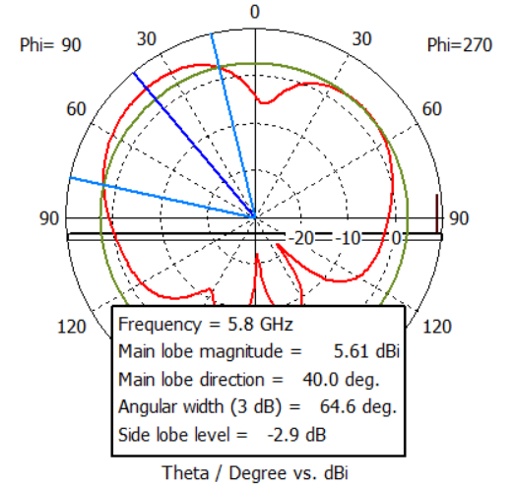
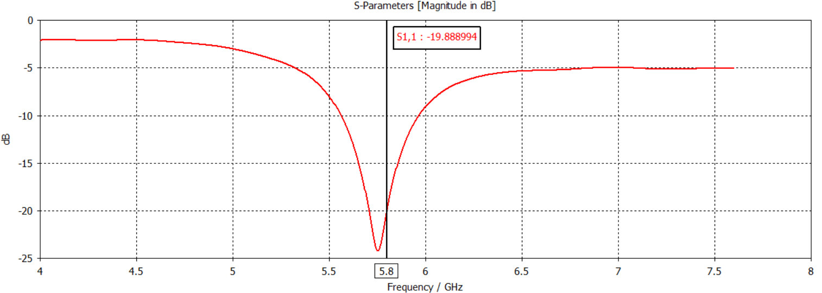
2x2 Antenna Array
2x2 Structure
Inset Matching
Quarter Wave Transformer on the feed network
Notes:
In the 2x2 array, we tried to design a symmetrical structure with inset feeding and quarter wave transformer on the feed network. In the radiation pattern plot, we can say that the patches create two main lobes and because of it, the directivity angle is very bad. But we can say that, even for this spreaded pattern, the gain is increased in array structure.

Slide 20
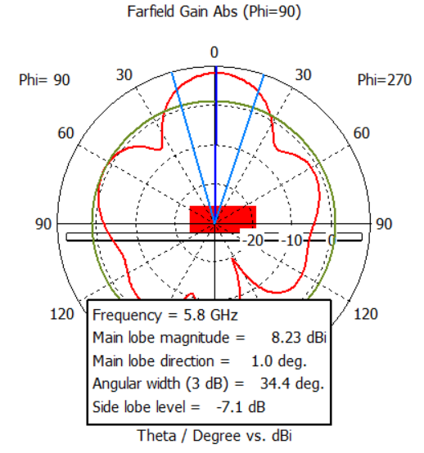
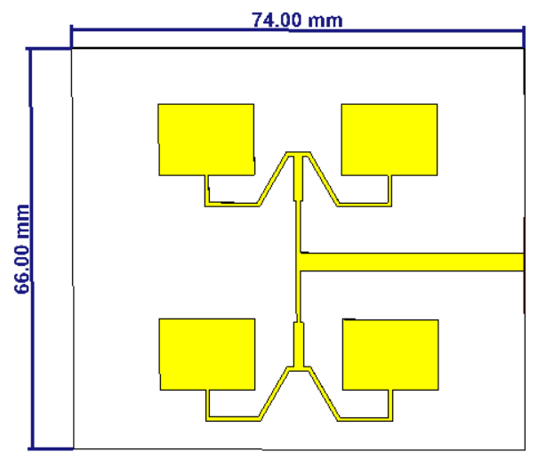
2x2 Antenna Array - Improved
One main lobe
Improved gain and directivity
Notes:
Then we improved the design to create one main lobe.
We deleted the inset matching and use only quarter wave transformers. We also use different angles on the feed network to adjust patch distances.
If we compare the resulting plot, we can say the pattern is improved and gain is increased a well amount.
Although it satisfy our main points, we wanted a lower sidelobe level.

Slide 21
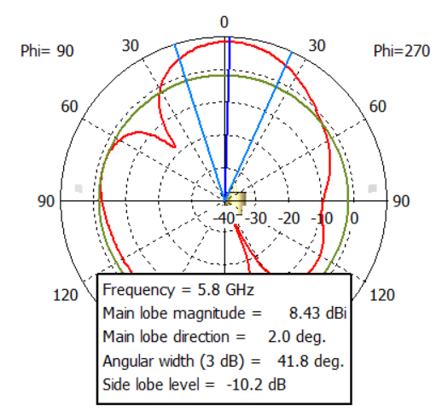
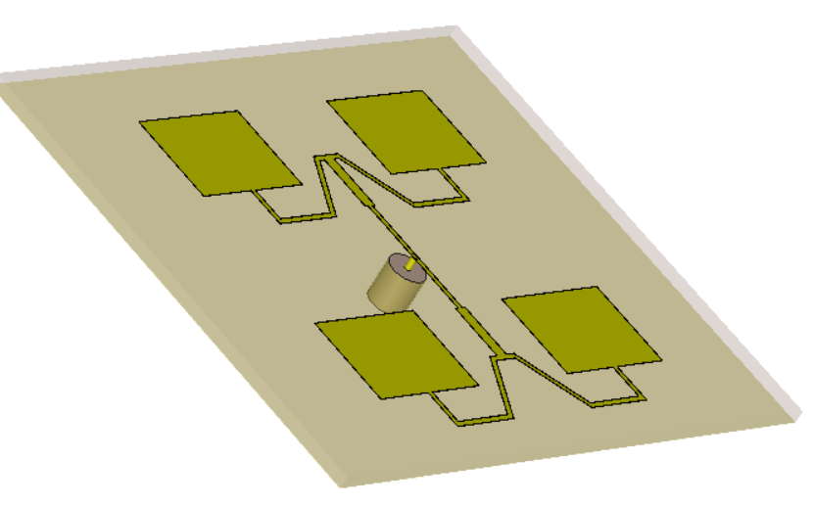
2x2 Antenna Array – Coax Feed
Notes:
In the 2x2 array we tried many different things to decrease the sidelobe levels, one of them is adding coaxial feed instead of side main feed.
We throw away this design because of the results and the fabrication difficulty.
Emre will continue with the other structures we designed.

Slide 22
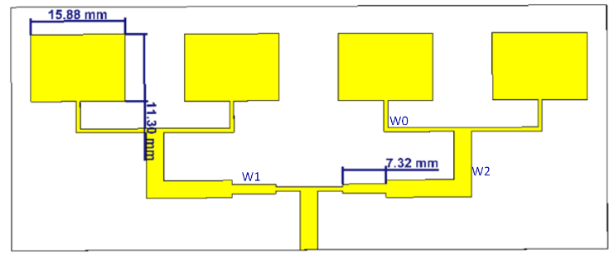
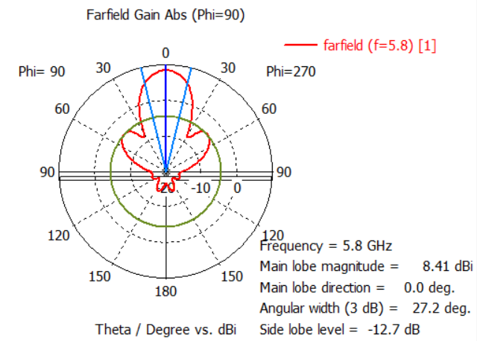
1x4 Antenna Array
Appropriate Directivity
Relatively small side lobes
Sufficient Gain
Notes:
Next, We desgined 1x4 antenna array with edge feed and quarter wave transformer.
In this way, designing feed network became easy and unsymmetric effect of the main feed is canceled because all the patches are side by side.
As we can see in the radiation pattern diagram, this antenna has approppriate directivity with relatively small side lobes. Also, it has pretty sufficient gain level.
Ulitmately, The characteristic of this antenna is what we wanted. Therefore, at our next antenna designs, we focused on developping this design for less side lobes.

Slide 23
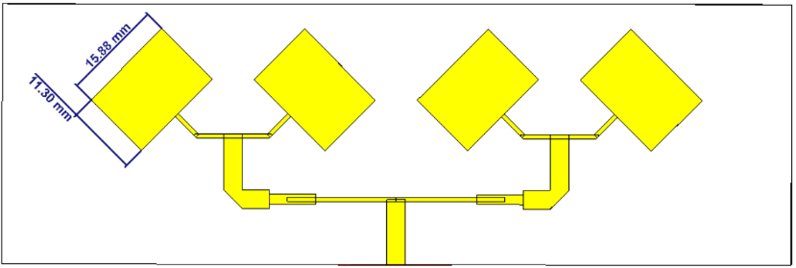
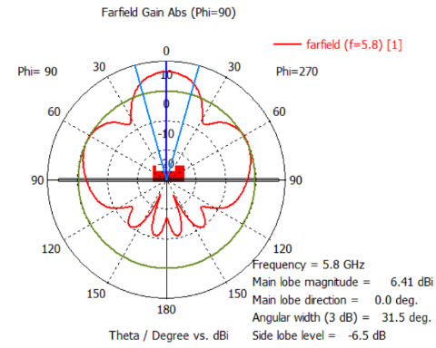
1x4 Antenna Array - Tilted
45 Degree Tilt
Smoothed edges
Notes:
We modified the antenna by tilting the patches by 45 degree and smoothing the edges.
it has adequate S11 parameter even better than our other designs. However, we saw decrement at gain and increament at side lobes as seen in the figure below.
Therefore, we wanted to focus on the antenna I mentioned earlier.

Slide 24
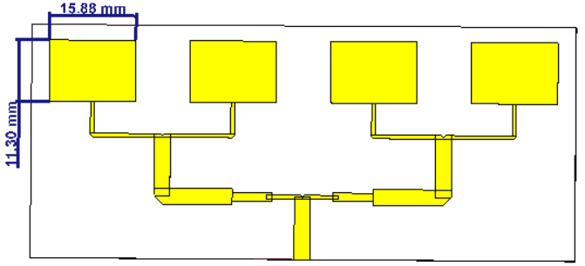
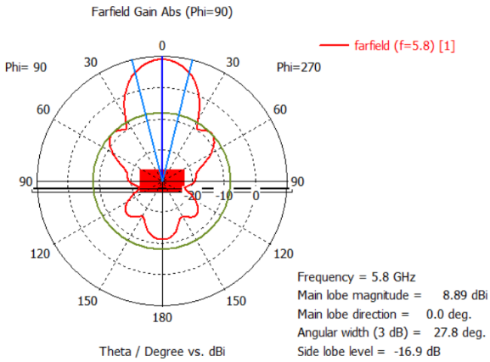
Final Design
Smoothed edges
Reduced side lobes
Wide bandwidth
Notes:
This is our final antenna design. We developed the antenna by smoothing the edges, and changing other parameters ittertively to find the best one possible. As seen in the radiation pattern, we reduced the side lobes significantly by increasing the gain to 8.89dBi.
After deciding the structure and the fabrication process, we wanted to optimize the design for non-professional production.

Slide 25
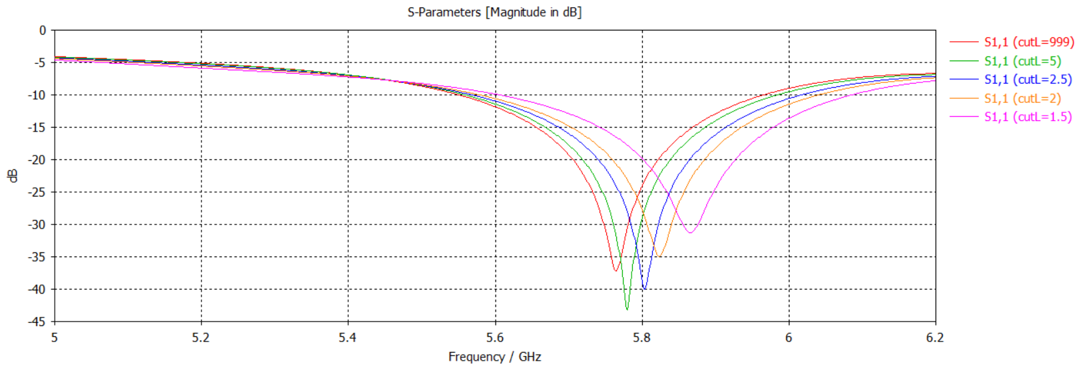
Final Design Optimizations - I
Smoothing sweep
Notes:
For this optimization, we increased the bandwidth of the antenna to minimize any S11 shift effect.
To increase the bandwidth we tried to smooth the edges of feed network. We sweeped the parameter itteratively to find the optimal smothness level.
As you can see in the figüre, the antenna bandwidth is increased.

Slide 26
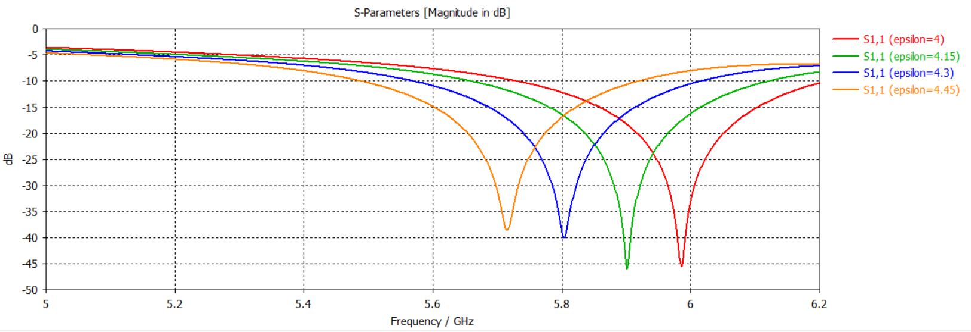
Final Design Optimizations - II
Dielectric Sweep
Notes:
Then, we tested different dielectric constant parameters due to non Professional fabrication. As seen in the figüre, small dielectric constant differences direcly sihft our s11 parameter.
Even though, our material has slightly different dielectric constant, our return loss is sufficient at 5.8GHz according to the simulation.
Now, I will give you information about fabrication costs and production process.

Slide 27
Fabrication Cost
UV exposure method
Materials:
UV exposure device
FR4 Positive Photoresist Copper Clad
Antenna layout on transparent slide
Sodium Hydroxide (NaOH) and Sodium Persulfate (Na₂S₂O₈)
Vendors | Price
Stores at Çankaya | $100
ARIKAN PCB | $120 per 5 pieces
Megasistem PCB | $35 + materials
Özdisan | $90 per 5 pieces
Tamara | $20 after Jan 5
PCBWay | $70 per 5 pieces
Notes:
According to our market research, there is no convinient professional solution for our budget as seen in the table.
Therefore, We wanted to produce our antenna with UV exposure method. It is one of the most precise method for amateur production.
For this method, we need various materials. Thankfully, there is an UV exposure device at laboratory and we supplied chemicals on our own.
We are supposed to follow several steps strickly to get proper result from our production process.

Slide 28
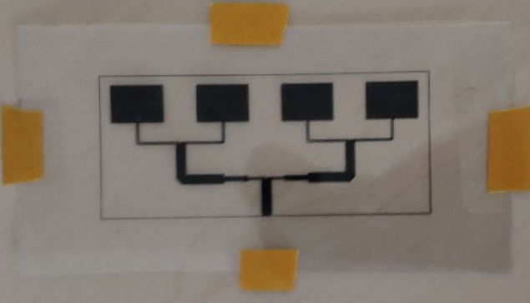
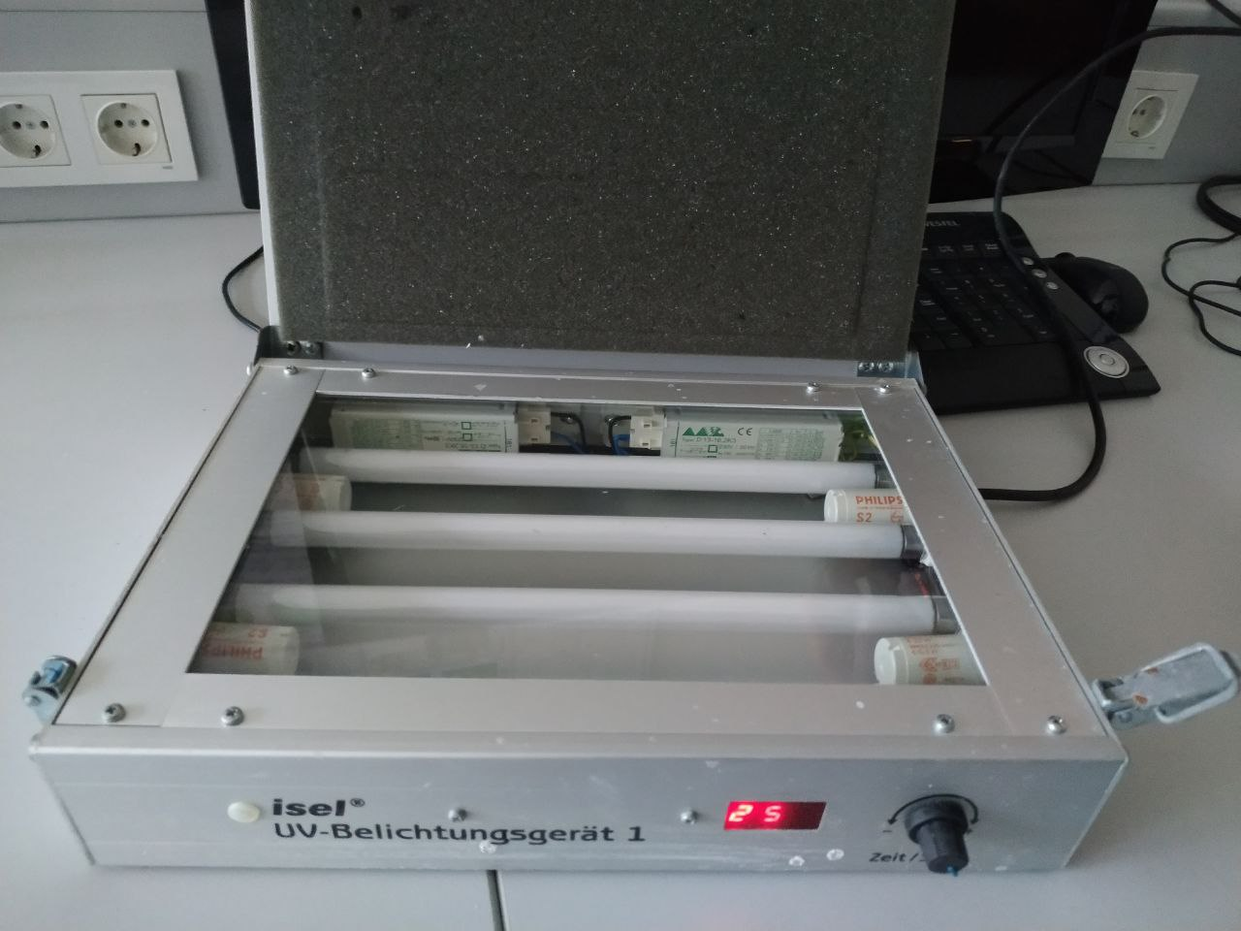
Fabrication Cost - I
UV Exposure
Notes:
Firstly, we taped the transparent layout to a copper clad.
Then,we applied UV expsosure to it for several minutes.
In process, UV light started chemical reaction on the photoressist layer of the copper clad.

Slide 29
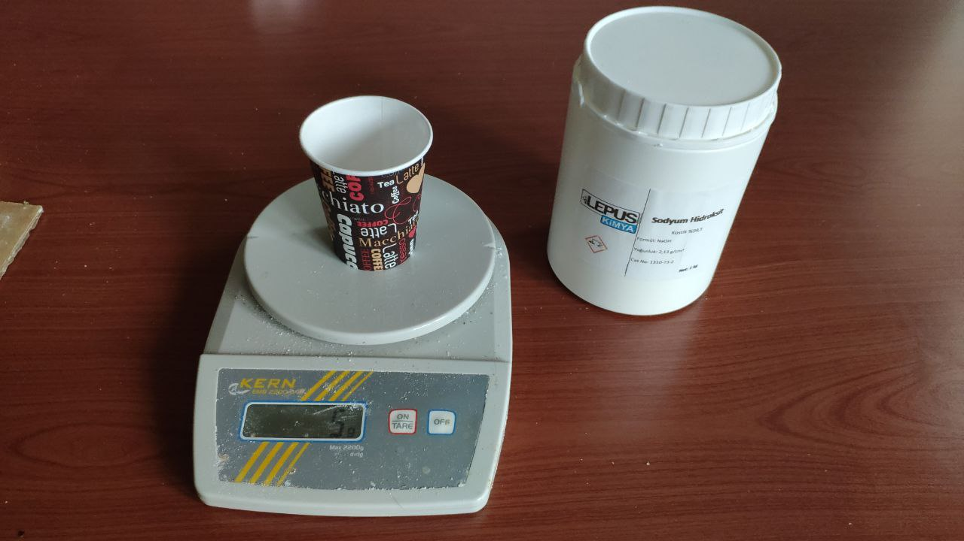
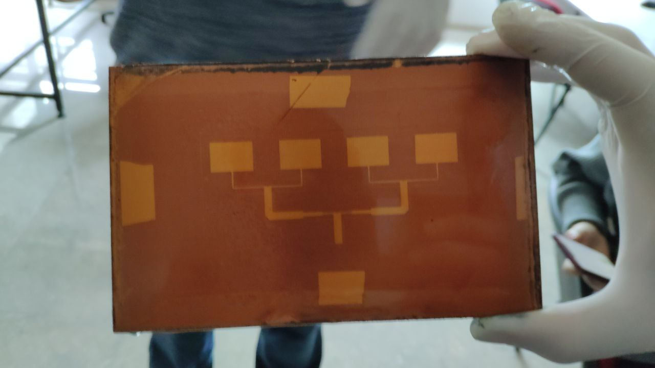
Fabrication Cost - II
Dissolving Photoresist Layer
Notes:
Next, we washed the board with sodium hydroxide solution in a container.
After several minutes, we took off the board when undesired photoresist has gone.
Then, we washed the board with water. At the end our board was like right figüre. Antenna section still has photoresist layer on it.

Slide 30
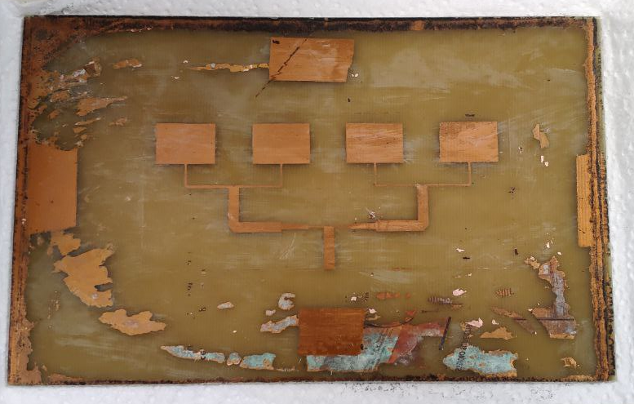

Fabrication Cost - III
Etching
Notes:
Then, we started another washing process with etching solution of Sodium Persulfate.
This process dissolved the copper layer other than patches and it took around 30 minutes.
You can see the End product in the right figüre. We see copper chunks around the antenna however they will be gone when we trimm them off.

Slide 31
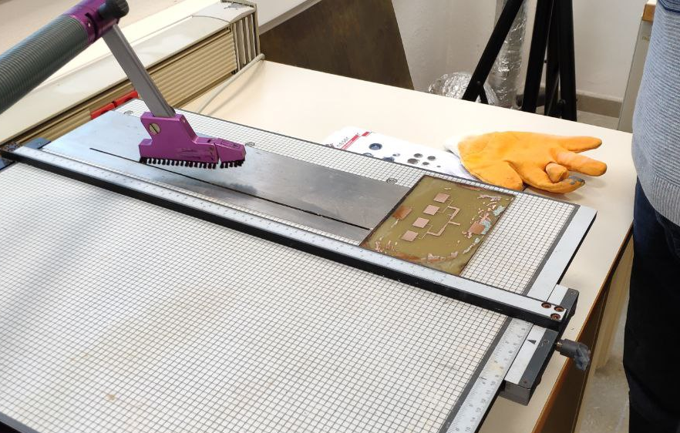
Fabrication Cost - IV
Trimming off
Notes:
So, in the last step, we removed the photoresist layer with acetone and trimmed the excessive parts with a table saw.

Slide 32
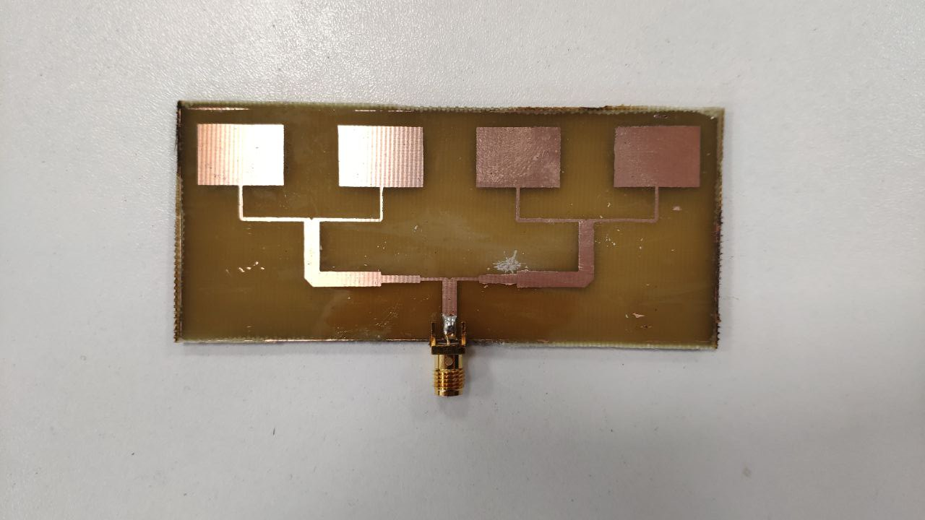
Fabrication Cost - V
Final Product
Notes:
And our antenna is done after soldering the coaxial socket.
Now, Ahmet will continue.

Slide 33
Results
Measurements
Comparing
Notes:
After fabrication, we did our measurements thanks to our labs. Then we did some comparisons with the simulation results.

Slide 34
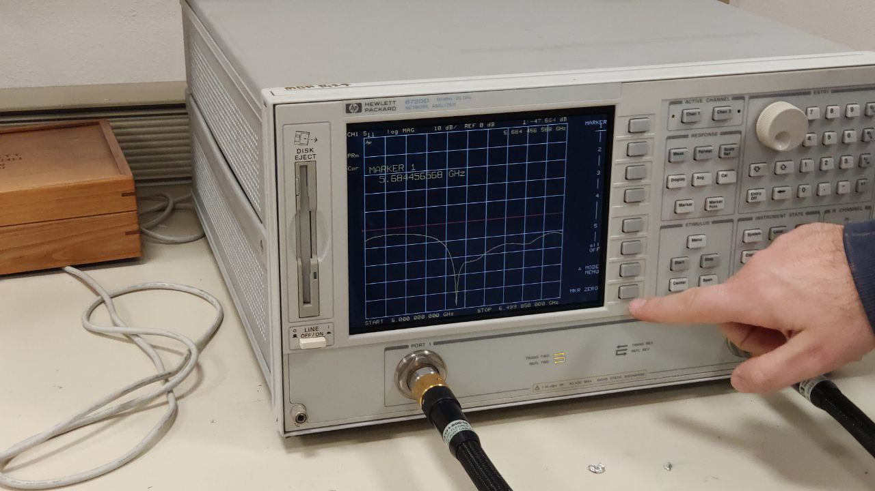
Measurements - I
Return Loss Measurement
Notes:
The first measurement is done on the network analyzer. We use the first port of it to measure S11 parameter.

Slide 35
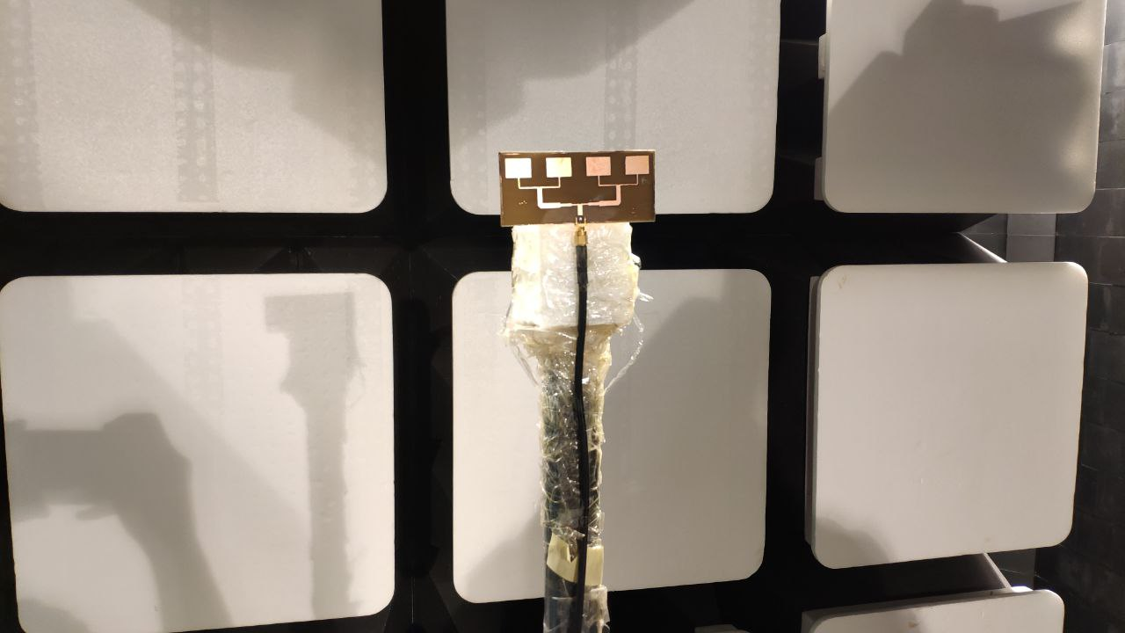
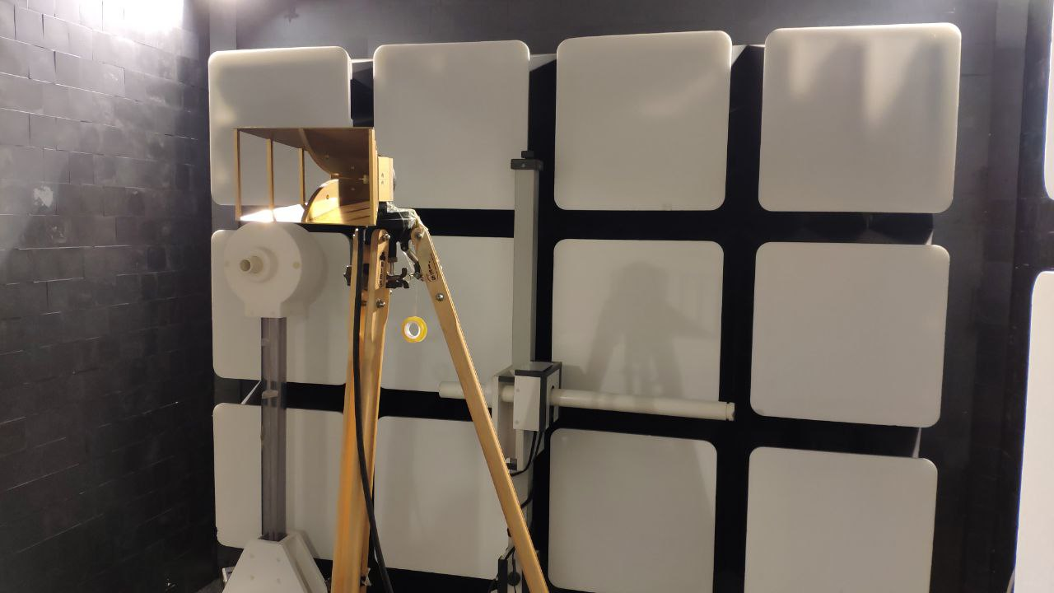
Measurements - II
Radiation Pattern Measurement
Notes:
Second measurement is done at the anechoic chamber. We used signal generator with our antenna as a transmitter, and a spectrum analyzer with a referance horn antenna as a receiver.

Slide 36
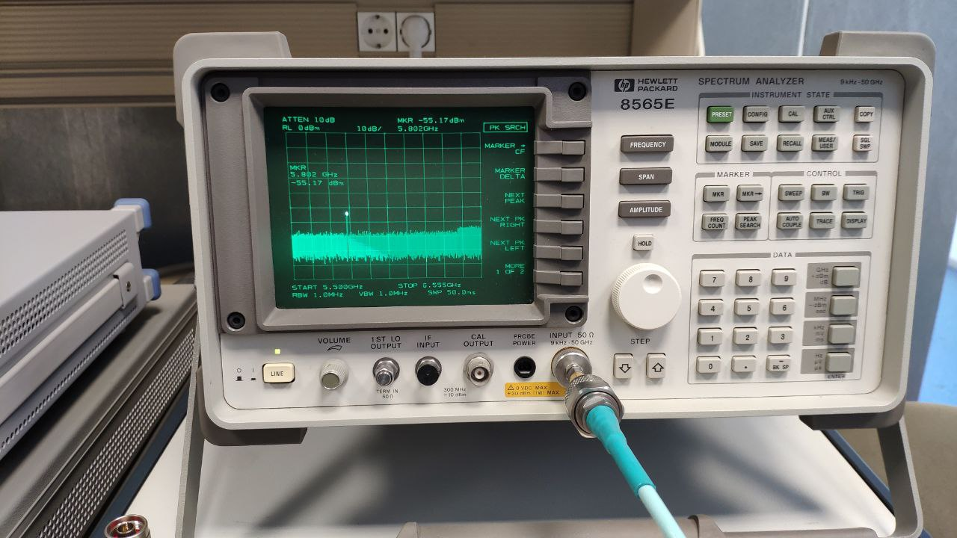
Measurements - III
Radiation Pattern Measurement
Notes:
With this configuration, we referenced another horn antenna to compare the impulse amplitudes, and find the gain of our antenna.

Slide 37
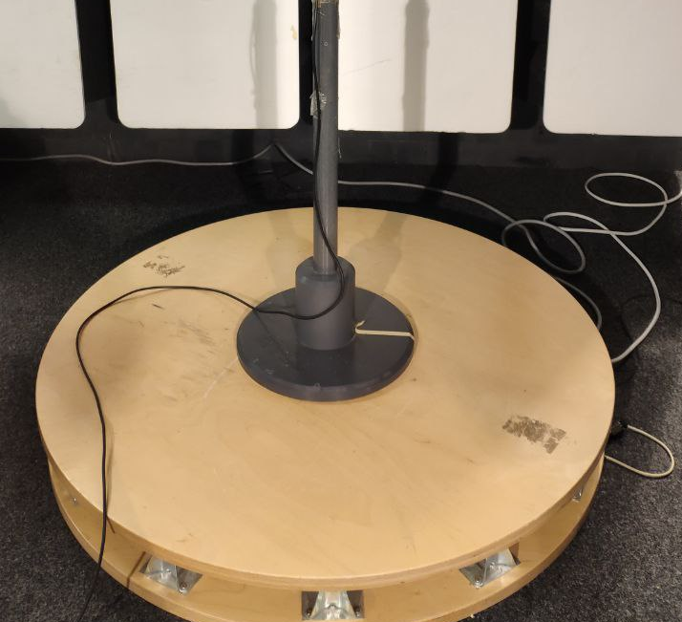
Measurements - IV
Radiation Pattern Measurement
Notes:
Turn table helped us to rotate the antenna direction with its precise control unit. We use it to measure the gain at all angle values.

Slide 38
Comparison - I
Return Loss Comparing
Notes:
At the final we got the data from measurement devices and CST simulation to compare them on MATLAB.
On the figure, firstly, our best frequency value is shifted, and our operating frequency is on a flat band on -20 level which is very good actually.
And secondly, the bandwidth of the antenna is increased 5.5 to 6.8.

Slide 39
Comparison - II
Radiation Pattern Comparing
Notes:
On the radiation pattern figure, the maximum gain is decreased a bit, and the directivity pattern is mostly matched epacially around 0 degree.
Also, you can observe that the result is not going under -22 dbm value especially at 100 degress, but this happened because of the signal generator power limitation.

Slide 40
CONCLUSION
Problems
Simulation and Calculations
Simulation and Results
Anechoic Chamber
Future Radar Project
Notes:
In conclusion, we had to figüre out different problems step by step. At the beginning of the project, our main concern was S11 parameter of the antenna. However, later we started to consider the importance of other parameters for doppler radar implementation such as gain and directivity.
Also, We expected our simulation to match with our analytical calculation, but we see that it rarely matches. Therefore, rather than calculation, we focused on iterative simulation trials.
In addition, At S11 results, we saw differences, but it has distinct similarities with our antenna mainly on our focus area.
From measurements, we used anechoic chamber and learned microwave devices and equipments.
As the main aim of the Project, we ended up a properly working 5.8GHz microstrip antenna for dopler radar implementation. For the future work, we want to use this antenna with a Vivaldi antenna for test and comparison.
This is the end of our presentation,
Thank you for listening.

Slide 41
REFERENCES
[1] A. Karatay, D. Orcan, C. Özkal, and F. Yaman, “Implementation and experimental
verifications of microstrip antennas for angular scanning of a Doppler radar,” AEU -
International Journal of Electronics and Communications, vol. 101, pp. 76–84, 2019.
[2] D. M. Pozar and D. H. Schaubert, “basic microstrip antenna elements and feeding
techniques,” in Microstrip antennas: The analysis and design of microstrip antennas and
arrays, New York: Institute of Electrical and Electronics Engineers, 1995, pp. 60–90.
[3] A. Pandey, Practical Microstrip and printed antenna design. London, Boston: Artech House, 2019.
[4] C. A. Balanis, Antenna theory: Analysis and design. Hoboken: John Wiley, 2016.
[5] D. M. Pozar, Microwave engineering. New York: John Wiley & Sons, ., 2005.
[6] D. S. Sawicki, “Police Doppler Radar,” Police Radar Information Center. [Online].
Available: https://www.copradar.com/chapts/chapt3/ch3d1.html. [Accessed: 01-Dec-2021].
[7] Radar bands. [Online]. Available: https://www.everythingweather.com/weatherradar/bands.shtml. [Accessed: 27-Nov-2021].

